Slide 1
COMPLEX AMALGAM RESTORATIONS

Slide 2
INTRODUCTION
Complex posterior restorations are used to replace any missing structure of teeth.
Fractured
Severe caries involvement
Existing restorative material

Slide 3
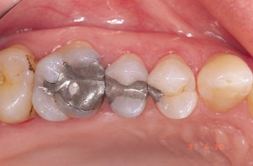
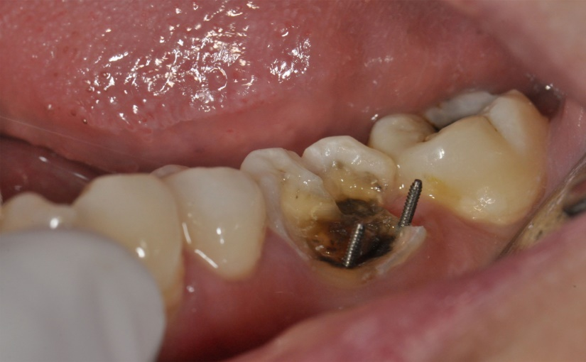
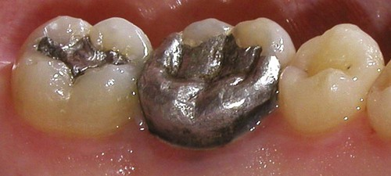
These restorations usually involve the replacement of one or more missing cusps and require additional means of retention.

Slide 4
Presence of coronal tooth tissue surrounding a restoration – primary retentive and resistance features.
Absence of coronal tooth tissue with little or no clinical crown – retention with pins, coves, slots etc.
FAILURE
COMPLEX AMALGAM RESTORATIONS

Slide 5
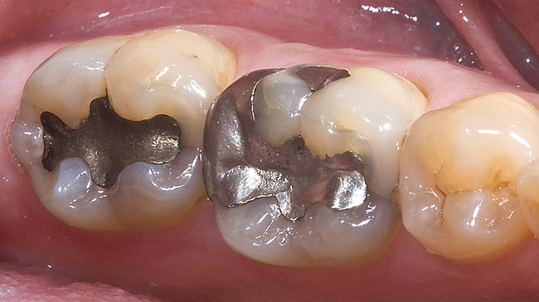
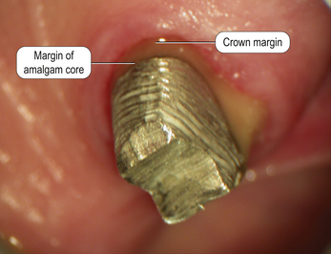
INDICATIONS
Definitive Final restoration
Foundation restoration
Control restoration
Interim restoration

Slide 6
Grossly mutilated teeth
Extended preparations
Extensive class V restorations
Cross splinting
Questionable prognosis
Economical factors

Slide 7
CONTRAINDICATIONS
In patients with significant occlusal problems.
Anatomical or functional considerations.
Esthetic importance for the patient.

Slide 8
ADVANTAGES
Conservation of tooth structure
Appointment time
Resistance and retention forms
Economics

Slide 9
DISADVANTAGES
Tooth anatomy
Dentinal crazing and fractures.
Decreased strength of amalgam
Penetration and perforation.
Microleakage

Slide 10
PIN RETAINED AMALGAM RESTORATIONS
Definition :
A Pin retained restoration may be defined as any restoration requiring the placement of one or more pins in dentin to provide adequate resistance and retention form.

Slide 11
Indications :
Restoration of mutilated and badly broken down teeth.
Young patients
Transitional restoration in badly broken down teeth prior to endodontic or orthodontic treatment.
Foundations for partial or full veneer cast restoration or metalo-ceramic restorations.
Questionable prognosis- endodontically or periodontically
Cross-linkage mode between two bulky, sound parts of the remaining tooth structure.
Economical restoration
Operative Dentistry – Modern Theory and Practice - Marzouk

Slide 12
Types of pins :
TYPES
Cemented pins
Friction lock pins
Self threaded pins
Sturdevant’s Art & Science of Operative Dentistry – A South Asian edition

Slide 13
Cemented pins:
Markley – 1958
Pins – 0.001 – 0.002 inch ( 0.025mm-0.05mm ) smaller than pin channels.
Pin sizes – 0.019inch, 0.025inch ; 0.021inch, 0.027inch
Cementing medium – Zinc phosphate cement or cyanoacrylate cement, Reinforced ZOE, Glass ionomer cement
Sturdevant’s Art & Science of Operative Dentistry – A South Asian edition
Principles and Practice of Operative Dentistry – Charbeneau – 3rd edition

Slide 14
Endodontically treated teeth
Location of pin close to DEJ
U and L shaped pins in class IV
Highly mineralised dehydrated dentin, sclerotic dentin
Operative Dentistry – Modern Theory and Practice - Marzouk

Slide 15
2 ) Friction lock pins :
Goldstein in 1966
In this type, the pin channel diameter is 0.001 inch (0.025 mm) narrower than the pin diameter.
These pins are 2-3 times more retentive than cemented pins.
The pins are tapped into dentin, retained by the resiliency of dentin.

Slide 16
Used in vital teeth only
Bulky dentin should be encompassing the pin
2.5mm away from the DEJ
Used only in accessible areas in the mouth

Slide 17
3) Self threaded pins:
Going -1966.
Most frequently used
Pins – 0.0015- 0.004 inch larger than pin channel.
Resiliency of dentin – Retention.
Most retentive, 3-6times.
Depth hole – 2mm.
Sturdevant’s Art & Science of Operative Dentistry – A South Asian edition

Slide 18
Thread Mate System (TMS) :
Gold plated stainless steel pins
Titanium pins
Versatality
Wide range of sizes
Color coding system
Greater retentiveness
Sturdevant’s Art & Science of Operative Dentistry – A South Asian edition

Slide 19
Pin Placement Factors :
Pin Size :
Regular (0.031 inch/0.78mm)
Minim (0.024 inch / 0.61mm)
Minikin (0.019 inch / 0.48mm)
Minuta (0.015 inch / 0.38mm)
Amount of dentin available
Amount of retention required
Severely involved posterior teeth – Minikin or Minim
Sturdevant’s Art & Science of Operative Dentistry – 5th edition

Slide 20
Sturdevant’s Art & Science of Operative Dentistry – 5th edition

Slide 21
Sturdevant’s Art & Science of Operative Dentistry – 5th edition

Slide 22
Number of pins:
FACTORS
Amount of missing tooth structure
Amount of dentin available
Amount of retention required
Size of pins
Sturdevant’s Art & Science of Operative Dentistry – 5th edition

Slide 23
As a rule, one pin per missing axial line angle should be used.
The fewest pins possible should be used to achieve the desired retention for a given restoration.
When only 2 to 3 mm of the occlusogingival height of a cusp has been removed, no pin is required.
Number of pins increases , so does the retention.
Sturdevant’s Art & Science of Operative Dentistry – 5th edition

Slide 24
Location of pins :
Occlusal clearance – 2mm
Should be positioned 0.5mm-1.0mm to the DEJ or 1.0mm – 1.5mm to the external surface of the tooth.
Pinhole should be parallel to the external tooth surface.
Sturdevant’s Art & Science of Operative Dentistry – 5th edition

Slide 25
0.5mm clearance around the circumference of pin.
Should be placed on flat dentinal floor.
Interpin distance 3mm(Minikin);5mm(Minim)
> 3 pins – Different vertical levels.
Sturdevant’s Art & Science of Operative Dentistry – 5th edition

Slide 26
The following factors help the clinician for pin placement:
Knowledge of anatomy
Radiographs
Outer surface of the tooth
Amount of dentin
Anatomical features
Tooth alignment
Relative age of patient
Operative Dentistry – Modern Theory and Practice - Marzouk

Slide 27
Pin design:
Standard
Self-shearing
Two-in-one
Link Series
Link Plus
Sturdevant’s Art & Science of Operative Dentistry – 5th edition

Slide 28
Sturdevant’s Art & Science of Operative Dentistry – 5th edition

Slide 29
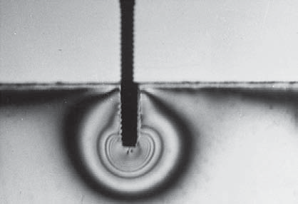
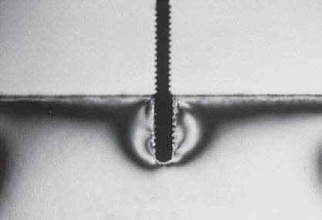
Standard pin :
7mm long with flattened head
Can be reversed one quarter to one half turn.
Sturdevant’s Art & Science of Operative Dentistry – 5th edition

Slide 30
Self- shearing :
The self-shearing pin has a total length that varies according to the diameter of the pin.
It also consists of a flattened head.
When the pin approaches the bottom of the pinhole, the head of the pin shears off, leaving a length of pin extending from the dentin.
Sturdevant’s Art & Science of Operative Dentistry – 5th edition

Slide 31
Two in One pin :
The two-in-one pin is actually two pins in one, with each one being shorter than the standard pin.
9.5mm
When the pin reaches the bottom of the pinhole, it shears approximately in half, leaving a length of pin extending from the dentin with the other half remaining in the hand wrench or the handpiece chuck.
Sturdevant’s Art & Science of Operative Dentistry – 5th edition

Slide 32
Link series pin :
When the pin reaches the bottom of the hole, the top portion of the pin shears off, leaving a length of pin extending from the dentin.
The Minuta, Minikin, Minim, and Regular pins are available in the Link Series.
The Link Series pins are recommended because of their versatility, self-aligning ability, and retentiveness.
Sturdevant’s Art & Science of Operative Dentistry – 5th edition

Slide 33
Link plus pins:
The Link Plus pins are self-shearing and are available as a single or two-in-one pin contained in a color coded plastic sleeve.
This design has a sharper thread, a shoulder stop at 2 mm, and a tapered tip to fit the bottom of the pinhole more readily as prepared by the twist drill. It also provides a 2.7-mm length of pin to extend out of the dentin.
Sturdevant’s Art & Science of Operative Dentistry – 5th edition

Slide 34
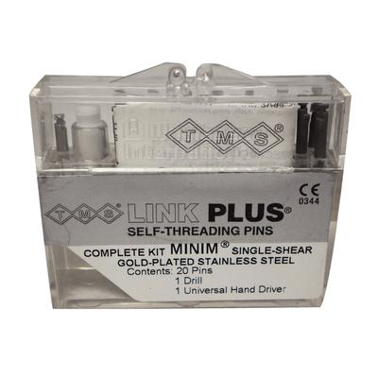
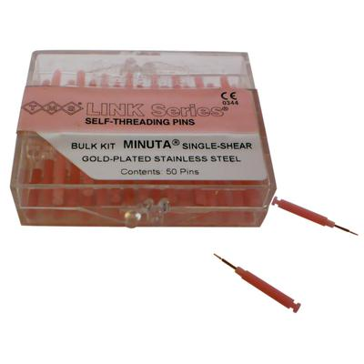

Slide 35
Tooth Preparation:
Sturdevant’s Art & Science of Operative Dentistry – 5th edition

Slide 36
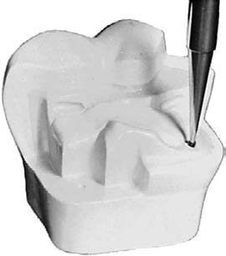
Pinhole preparation:
Pilot hole – No.1/4 round bur.
Sturdevant’s Art & Science of Operative Dentistry – A South Asian edition

Slide 37
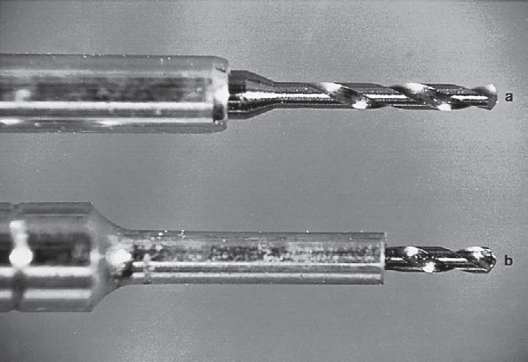

Slide 38
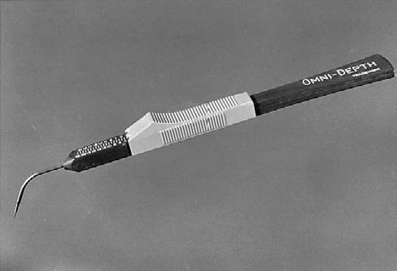

Slide 39
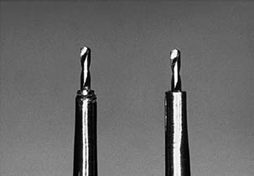
Standlee et al showed that a twist drill becomes too dull for use after cutting 20 pinholes or less, and the signal for discarding the drill is the need for increased pressure on the handpiece.
FRICTIONAL HEAT
CRACKS IN DENTIN
Sturdevant’s Art & Science of Operative Dentistry – 5th edition

Slide 40
5 rules for using twist drills :
300-500 rpm
Direct cutting acts, No lateral cutting acts
Revolving while inside the pin channel
No pumping strokes
Never to be used in enamel.
Operative Dentistry – Modern Theory and Practice - Marzouk

Slide 41
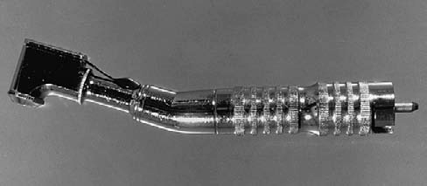
Pin Insertion :
Sturdevant’s Art & Science of Operative Dentistry – 5th edition

Slide 44
Possible problems with pins :
Failure of pin retained restoration :
FAILURE
Within the restoration
Interface between pin and restoration
Within the pin
Interface between pin and dentin
Within the dentin
Sturdevant’s Art & Science of Operative Dentistry – 5th edition

Slide 46
2) Broken drills and Broken pins
3) Loose pins
4) Penetration into the Pulp and Perforation of the External Tooth Surface
Sturdevant’s Art & Science of Operative Dentistry – 5th edition

Slide 47
Factors influencing stress created by pins:
Type of pin
Diameter of pin
Pin depth and dentinal engagement
Operative Dentistry – Modern Theory and Practice - Marzouk

Slide 48
d)Bulk of dentin
e)Type of dentin
f) Interpin distance
Operative Dentistry – Modern Theory and Practice - Marzouk

Slide 49
g) Pin channel circumference:
h) Loose pins
i) Irregular shaped dentinal ends of pins
Operative Dentistry – Modern Theory and Practice - Marzouk

Slide 50
j)Ratio of depth of pin in dentin
k) Number of pins In one tooth
l) Twist drill variability
m) Overdriving or overthreading of pins
n) Stresses induced during shortening of pins
o) Bending pin
Operative Dentistry – Modern Theory and Practice - Marzouk

Slide 51
Design features:
Operative Dentistry – Modern Theory and Practice - Marzouk

Slide 52
Operative Dentistry – Modern Theory and Practice - Marzouk

Slide 53
Operative Dentistry – Modern Theory and Practice - Marzouk

Slide 54
Operative Dentistry – Modern Theory and Practice - Marzouk

Slide 55
Horizontal pins have been recommended to tie tooth structure to amalgam restorations.
Burgess found the most effective reinforcement of a free-standing facial cusp of a maxillary premolar was obtained with the use of two horizontal self-threading pins.
Retention and resistance features for complex amalgam restorations- James W. Robbins JADA, Vol. 118, April 1989

Slide 57
SLOT RETAINED AMALGAM RESTORATIONS
Definition:
A slot is a horizontal retention groove in dentin.
Indications:
Conjunction or alternative to pins
Preparations with vertical walls that allow retention locks to oppose one other
Short clinical crowns
Sturdevant’s Art & Science of Operative Dentistry – A South Asian edition

Slide 58
Advantages:
Less likely to create microfractures
Less chances of perforation into pulp
Retention potential of pins and slots is same.
Disadvantages:
More tooth structure is removed.
Sturdevant’s Art & Science of Operative Dentistry – A South Asian edition

Slide 59
No. 33 ^{1/2} bur is used to place a slot 0.5mm axial of the DEJ.
Continous or segmented
Shorter slots = Longer slots
Sturdevant’s Art & Science of Operative Dentistry – 5th edition

Slide 60
In 1979, Outhwaite and coworkers introduced the circumferential slot prepared with a no. 33^{1/2} inverted cone bur.
Retention and resistance features for complex amalgam restorations- James W. Robbins JADA, Vol. 118, April 1989

Slide 61
Retention and resistance features for complex amalgam restorations- James W. Robbins JADA, Vol. 118, April 1989

Slide 62
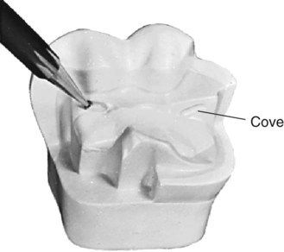
COVES
Cove is a retention feature.
No. ¼ bur
Sturdevant’s Art & Science of Operative Dentistry – A South Asian edition

Slide 63
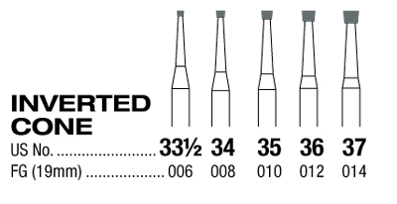
AMALGAM INSERTS
Seng and others – 1980
No.35 inverted cone bur
1.4mm in depth and diameter
Retention and resistance features for complex amalgam restorations- James W. Robbins JADA, Vol. 118, April 1989

Slide 64
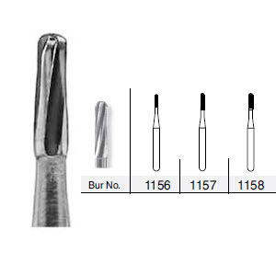
AMALGAPINS
Shavell – 1980
Variation of amalgam inserts
No.1156,No.1157,No.1158 bur
2-3mm in depth, 0.8mm
Retention and resistance features for complex amalgam restorations- James W. Robbins JADA, Vol. 118, April 1989

Slide 66
AMALGAM FOUNDATIONS
Pin retention, Slot retention, Chamber retention.
Kane et al ….. 2- 4mm extension into root canal
Sturdevant’s Art & Science of Operative Dentistry – 5th edition
a

Slide 67
RESTORATIVE TECHNIQUE
1)Use of desensitizer or bonding agent.
2)Matrix placement
3)Inserting the amalgam
4)Contouring and finishing the amalgam.

Slide 70
CONCLUSION
The complex amalgam restoration remains a predictable, cost effective, and safe means for the restoration of posterior teeth that are missing large amounts of structure.
Restoration of normal anatomic contour can be readily established with amalgam through the use of slots, pins and customized matrix designs.

